Slide 1

Sort Utilities
Presented By
Appala Venkata Naga Vamsi

Slide 2
Sort Utility
sort data fields in ascending or descending
order or a combination.
select records for processing based on given
values in fields.
reformat records.
create multiple sort outputs in same sort
processing.

Slide 3
Copy
Descending Order
Ascending Order
Include
Sum
Date Format
Merge
Split

Slide 4
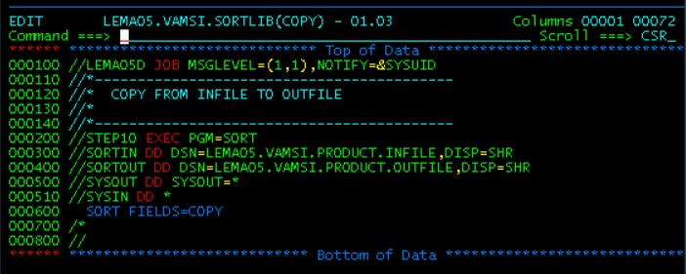
Copy :

Slide 5
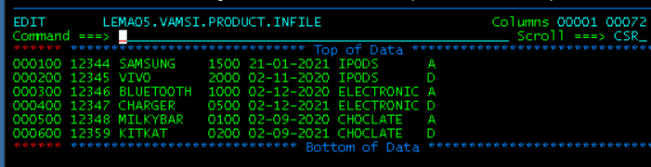
Input File:
LEMA05.VAMSI.PRODUCT.INFILE

Slide 6
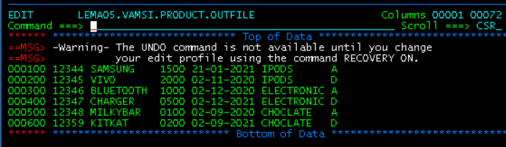
Output File:
LEMA05.VAMSI.PRODUCT.OUTFILE

Slide 7
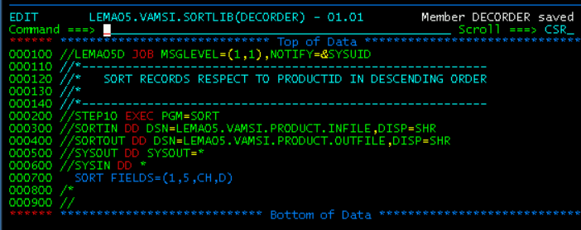
Descending Order:

Slide 8
Input File:
LEMA05.VAMSI.PRODUCT.INFILE

Slide 9
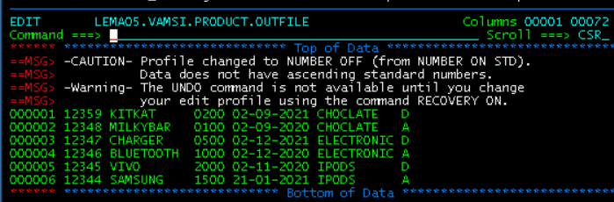
Output File:
LEMA05.VAMSI.PRODUCT.OUTFILE

Slide 10
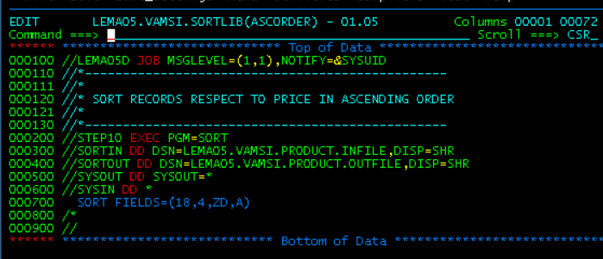
Ascending Order:

Slide 11
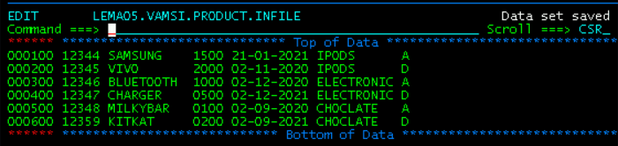
Input File:
LEMA05.VAMSI.PRODUCT.INFILE

Slide 12
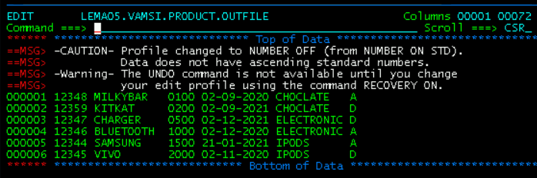
Output File:
LEMA05.VAMSI.PRODUCT.OUTFILE

Slide 13
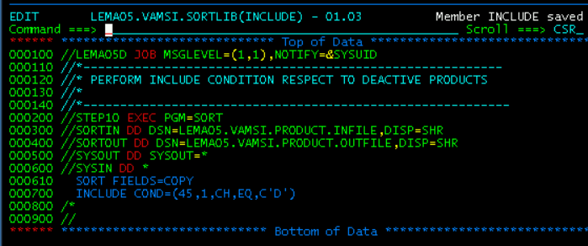
Include :

Slide 14
Input File:
LEMA05.VAMSI.PRODUCT.INFILE

Slide 15
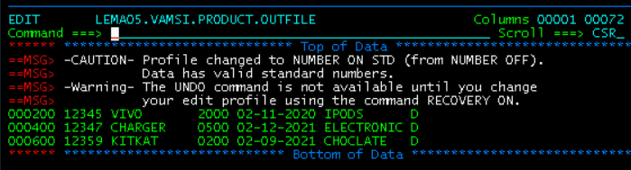
Output File:
LEMA05.VAMSI.PRODUCT.OUTFILE

Slide 16
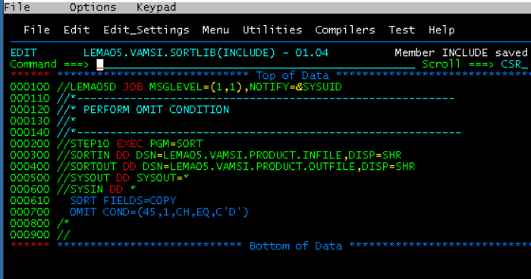
Omit:

Slide 17
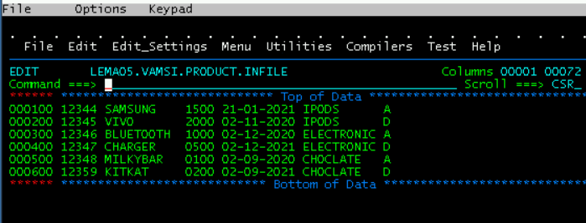
Input File:
LEMA05.VAMSI.PRODUCT.INFILE

Slide 18
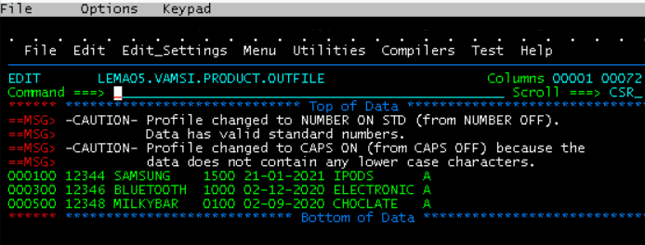
Output File:
LEMA05.VAMSI.PRODUCT.OUTFILE

Slide 19
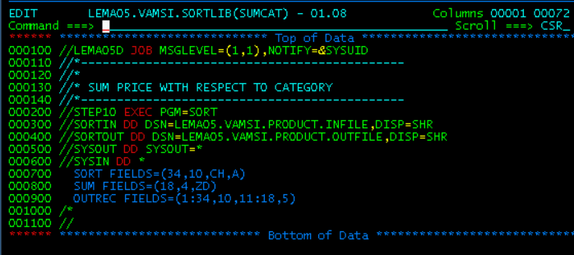
Sum :

Slide 20
Input File:
LEMA05.VAMSI.PRODUCT.INFILE

Slide 21
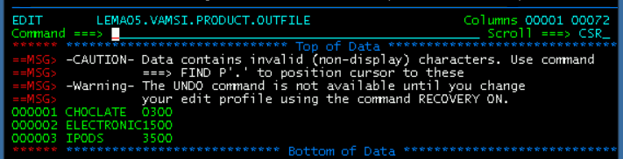
Output File:
LEMA05.VAMSI.PRODUCT.OUTFILE

Slide 22
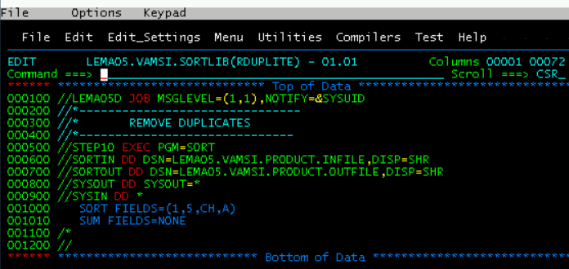
Duplicate:

Slide 23
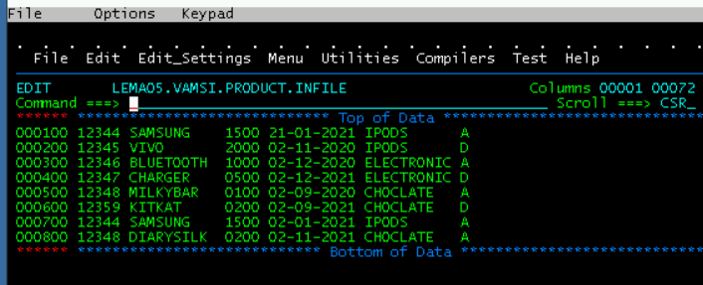
Input File:
LEMA05.VAMSI.PRODUCT.INFILE

Slide 24
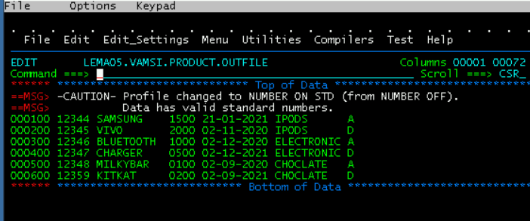
Output File:
LEMA05.VAMSI.PRODUCT.OUTFILE

Slide 25
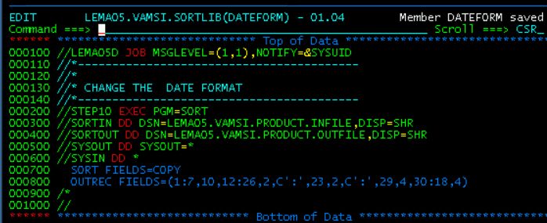
Date Format :

Slide 26
Input File:
LEMA05.VAMSI.PRODUCT.INFILE

Slide 27
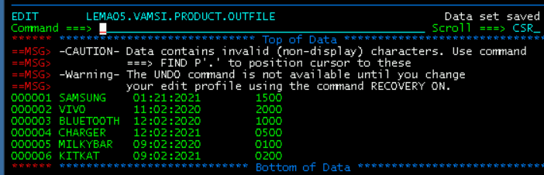
Output File:
LEMA05.VAMSI.PRODUCT.OUTFILE

Slide 28
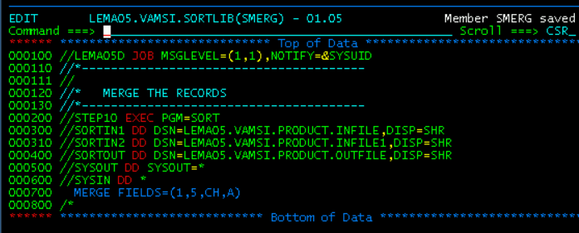
Merge :

Slide 29
Input Files:
LEMA05.VAMSI.PRODUCT.INFILE

Slide 30
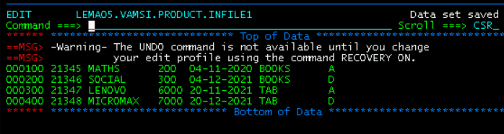
Input File1:
LEMA05.VAMSI.PRODUCT.INFILE1

Slide 31
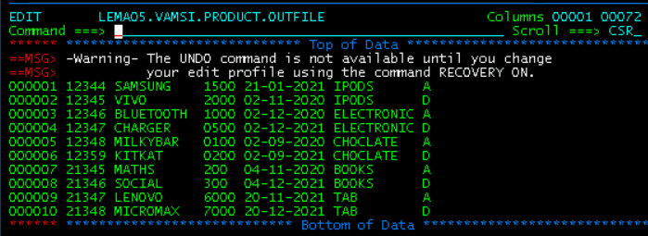
Output File:
LEMA05.VAMSI.PRODUCT.OUTFILE

Slide 32
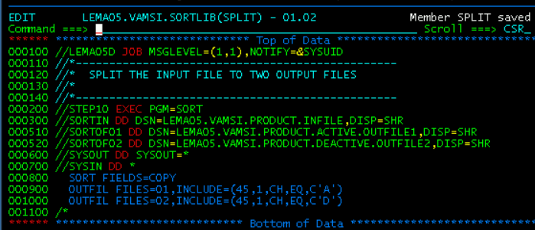
Split :

Slide 33
Input File:
LEMA05.VAMSI.PRODUCT.INFILE

Slide 34
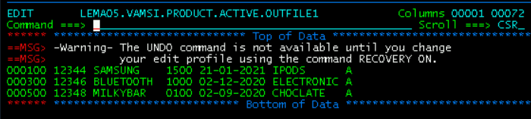
Output File:
LEMA05.VAMSI.PRODUCT.ACTIVE.OUTFILE1

Slide 35
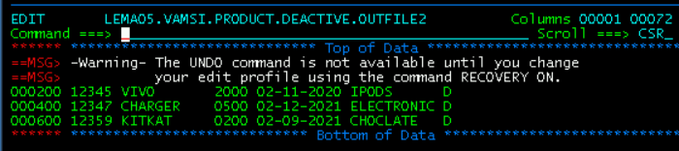
Output File1:
LEMA05.VAMSI.PRODUCT.DEACTIVE.OUTFILE2

Slide 36
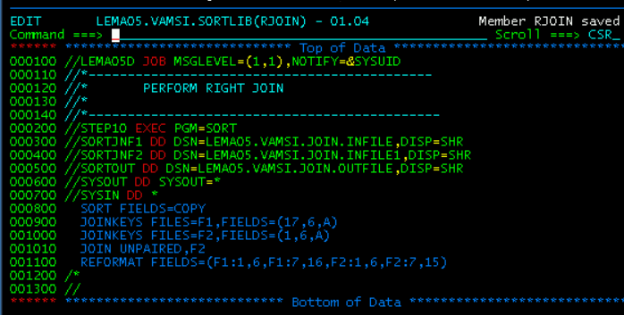
Right Join :

Slide 37
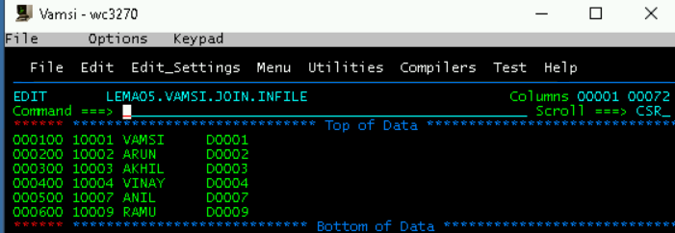
Input File:
LEMA05.VAMSI.JOIN.INFILE

Slide 38
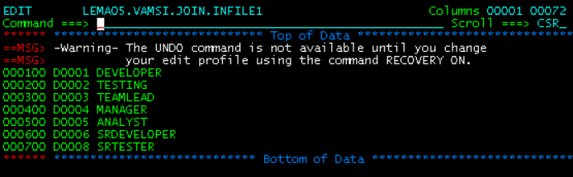
Input File1:
LEMA05.VAMSI.JOIN.INFILE1

Slide 39
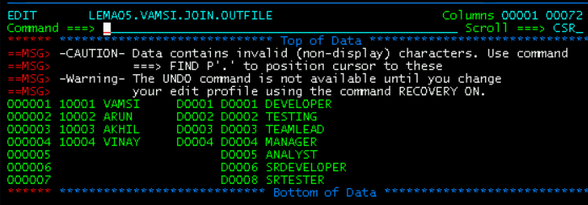
Output File:
LEMA05.VAMSI.JOIN.OUTFILE

Slide 40



Thank you
Reimagine technology to
accelerate your business
www.htcinc.com
www.caretech.com
www.ciber.com

